Slide 1
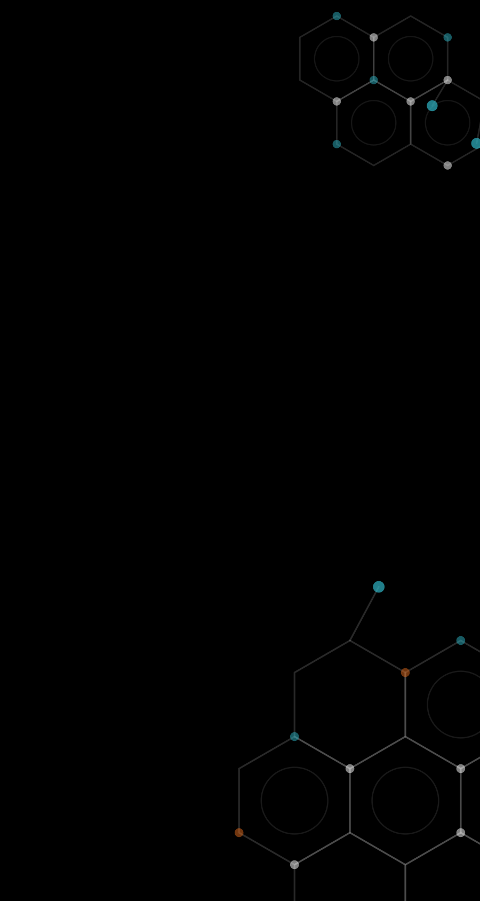



TEAM
G1535
MILESTONE-1 | DRUG DISCOVERY x MACHINE LEARNING
Department of CSE
Bioactive Molecule Prediction Using Extreme Gradient Boosting
1
Rishi
245325733131
Base paper: Mustapha & Saeed, Molecules 2016, 21, 983. XGBoost predicts biological activity better than RF, SVM, RBFN and NB.
2
Jeevan
245325733169
3
Anish
Bioactive molecule
Biological activity
245325733135
A chemical compound that has a measurable effect on a living system, for example a drug that binds to a target protein in the body.
The specific effect a compound produces on its target, such as blocking an enzyme or receptor. The paper labels molecules active or inactive.
4
Sanjay
245325733134
5
Balaji
245325733138
Notes:
[0:00-1:15] Good day everyone. My name is [Your Name], and I am part of Team G1535 from NGIT, Department of CSE. My teammates are Rishi, Jeevan, Anish, Sanjay and Balaji. Our project is 'Bioactive Molecule Prediction Using Extreme Gradient Boosting', based on the 2016 paper by Mustapha and Saeed in the journal Molecules. In one line, the paper shows XGBoost predicts biological activity better than RF, SVM, RBFN and Naive Bayes. Two quick definitions. A bioactive molecule is a chemical compound that has a measurable effect on a living system, for example a drug that binds to a target protein. Biological activity is the specific effect that compound produces on its target, like blocking an enzyme or receptor. In the paper, each molecule is labelled active or inactive.

Slide 2
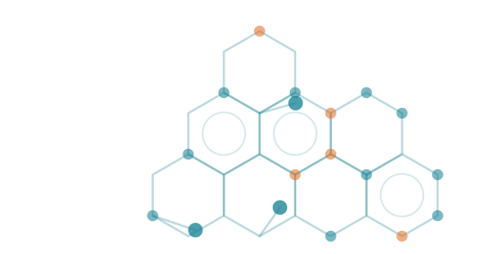

Understanding the Base Paper
02
Key idea
7
XGBoost adds many small decision trees, each one fixing the errors of the previous ones
Each molecule becomes a 1024-bit fingerprint (ECFC_4) and is labelled active or inactive
Regularization and shrinkage prevent over-fitting, even on imbalanced data
benchmark datasets: MDDR1-3, DUD, COX2, BZR, ER
98.49%
peak XGBoost accuracy (MDDR2); 94.47% on diverse MDDR3
Problem it solves, in simple words
#1
Testing millions of molecules in a lab is slow and costly. The paper teaches a computer to predict which molecules will be active, so chemists test only the best ones.
Ranked above RF, LSVM, RBFN, NB (Kendall W = 0.65)
Notes:
[1:00-2:15] The paper studies XGBoost, an ensemble of many decision trees built one after another, where each new tree corrects the mistakes of the earlier ones. Each molecule is converted into a 1024-bit fingerprint called ECFC_4, and the model learns to label it active or inactive. In simple words: lab testing of millions of molecules is slow and expensive, so the paper uses machine learning to predict activity first. The authors used seven datasets. XGBoost reached 98.49 percent accuracy on MDDR2 and 94.47 percent on the diverse MDDR3, and ranked first overall, above Random Forest, LSVM, RBFN and Naive Bayes.

Slide 3

Problem Definition
03
The problem
Why it matters
Key challenges
Finding active molecules by lab screening of huge chemical libraries is slow and costly. Machine learning can predict activity instead.
Data-driven drug discovery means fewer lab tests, a faster shortlist of candidate molecules and lower cost.
Existing methods struggle with accuracy, high-dimensional descriptors, imbalanced classes and interpretability.
Goal: predict whether a molecule is active or inactive from its structure, accurately even on imbalanced and diverse data.
Notes:
[2:15-3:15] The problem: in drug discovery, screening huge chemical libraries in the lab is slow and costly. This matters because a data-driven approach means fewer lab tests, a faster shortlist of candidate molecules and lower cost. The paper points out that existing methods struggle with predictive accuracy, high-dimensional descriptors, imbalanced classes and interpretability. So the goal is to predict active or inactive from structure alone, accurately, even on imbalanced and diverse data.

Slide 4

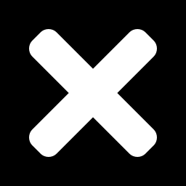
Scope of the Project
04
In-scope
Out-of-scope
Active / inactive prediction of molecules
7 datasets: MDDR1-3, DUD, COX2, BZR, ER
1024-bit ECFC_4 fingerprints, 70/30 split
XGBoost vs RF, LSVM, RBFN and NB
Parameter tuning + 10-fold cross-validation
ACC, SEN, SPC, AUC, F-score and Kendall W ranking
Wet-lab testing or compound synthesis
Docking and 3D structure-based methods
Deep learning and graph-based models
Datasets beyond the seven studied
Toxicity, ADMET or clinical prediction
Large-scale production deployment
In-scope = exactly what the base paper implements and evaluates.
Notes:
[3:15-4:15] In scope is exactly what the paper does: binary prediction of active or inactive molecules on seven datasets - MDDR1, 2 and 3, DUD, COX2, BZR and ER - using 1024-bit ECFC_4 fingerprints and a 70/30 train-validation split. XGBoost is compared with Random Forest, LSVM, RBFN and Naive Bayes, with parameter tuning and 10-fold cross-validation, and evaluated using accuracy, sensitivity, specificity, AUC, F-score and the Kendall W ranking. Out of scope are things the paper does not cover: wet-lab testing, docking and 3D methods, deep learning, other datasets, toxicity or clinical prediction, and large-scale production deployment.

Slide 5
Proposed Solution
05
Follow the paper's workflow
Validation scores: all metrics, all models
Average of the 7 datasets, from the paper's tables (axis starts at 0.6)
1
Encode 1024-bit fingerprints
2
Split 70% train / 30% validation
3
Train XGBoost, 10-fold CV
4
Compare with RF, LSVM, RBFN, NB
5
Score with 5 metrics + Kendall W
Expected outcome: XGBoost scores highest on average sensitivity, AUC, accuracy and F-score, and ranks first overall: XGBoost > RF > LSVM > RBFN > NB.
Notes:
[4:15-5:30] Our solution follows the paper's workflow. Step 1, encode molecules as 1024-bit fingerprints. Step 2, split 70 percent for training and 30 percent for validation. Step 3, train XGBoost with 10-fold cross-validation. Step 4, compare with Random Forest, LSVM, RBFN and Naive Bayes. Step 5, score with accuracy, sensitivity, specificity, AUC, F-score and the Kendall W ranking. The chart shows all five metrics for all five models, averaged over the seven datasets using the paper's validation tables. XGBoost is highest on sensitivity, AUC, accuracy and F-score; LSVM is slightly higher on specificity. The expected outcome is XGBoost ranking first overall.

Slide 6
Basic Architecture Diagram
06
Complete fingerprint
7 datasets
Training set
70%
Learning algorithm
XGBoost + 10-fold CV
Trained model
Split
Validation set
30%
Validation
Evaluation results
ACC, SEN, SPC, AUC, F-Sc
unseen data
XGBoost parameters (paper): eta 0.2, gamma 0.16, min child weight 5, max depth 16
NEXT MILESTONE
Trained model
Deployed model
Frontend: enter a molecule, view prediction
Notes:
[5:30-6:30] The top two rows follow Figure 1 of the base paper. The complete fingerprint dataset is split into a 70 percent training set and a 30 percent validation set. The training set goes into the learning algorithm, XGBoost with 10-fold cross-validation, which produces a trained model. The trained model is tested on the unseen validation set, giving the evaluation results: accuracy, sensitivity, specificity, AUC and F-score. The paper's best XGBoost parameters were eta 0.2, gamma 0.16, minimum child weight 5 and maximum depth 16. The dashed box at the bottom is our plan for the next milestone: take the trained model, deploy it, and give users a frontend where they enter a molecule and view the predicted activity.

Slide 7

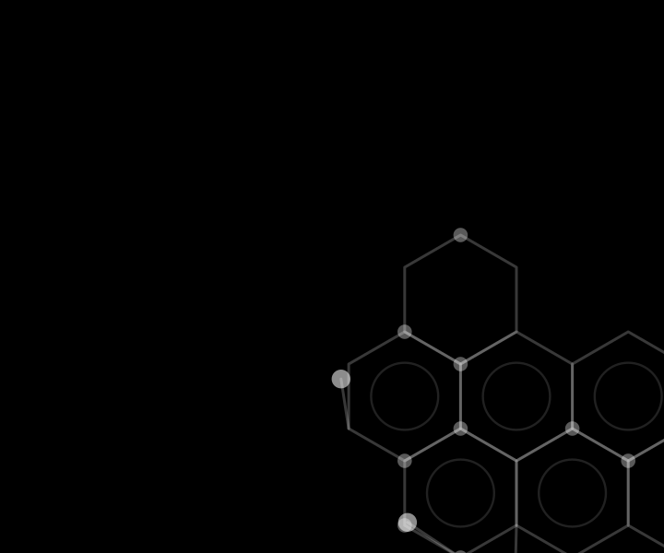
Recap and Next Milestone
07
What is planned
By next milestone, we plan to show...
1
Study XGBoost for bioactivity prediction
Prepared datasets: fingerprints and the 70/30 split
XGBoost results vs RF, LSVM, RBFN and NB
A working frontend to enter a molecule
A deployed model that returns the prediction
2
Work on the paper's 7 datasets
3
Compare with RF, LSVM, RBFN, NB
4
Evaluate with the paper's metrics
5
Build a frontend and deploy the model
Thank you | Team G1535 | NGIT - CSE
Notes:
[6:30-7:15] To recap: we will work through the paper's approach: XGBoost for bioactivity prediction on the seven datasets, comparing against RF, LSVM, RBFN and Naive Bayes, and evaluating with the paper's metrics. By next milestone, we plan to show prepared datasets with fingerprints and the 70/30 split, XGBoost results against the other four models, a working frontend where a molecule can be entered, and a deployed model that returns the prediction. Thank you.

